Slide 1


Embedded System Basics

Slide 2
Embedded System
An embedded system is a microprocessor-based computer hardware system with software that is designed to perform a dedicated function, either as an independent system or as a part of a large system. At the core is an integrated circuit designed to carry out computation for real-time operations.

Slide 3
Future Trends in Embedded Systems
The industry for embedded systems is expected to continue growing rapidly, driven by the continued development of Artificial Intelligence (AI), Virtual Reality (VR) and Augmented Reality (AR), machine learning , deep learning, and the Internet of Things (IoT).
According to a 2018 report published by QYResearch, the global market for the embedded systems industry was valued at $68.9 billion in 2017 and is expected to rise to $105.7 billion by the end of 2025.

Slide 4
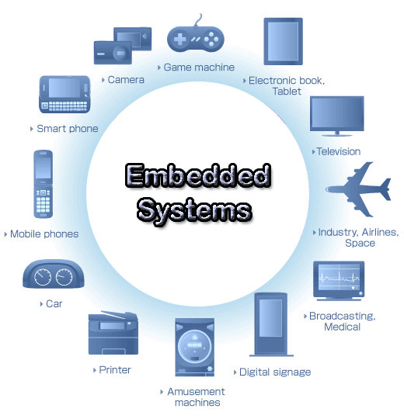

Slide 5
Embedded Systems in Automobiles and in telecommunications
Motor and cruise control system
Body or Engine safety
Entertainment and multimedia in car
E-Com and Mobile access
Robotics in assembly line
Wireless communication
Mobile computing and networking

Slide 6
Networking
Displays and Monitors
Networking Systems
Image Processing
Network cards and printers
Embedded Systems in Consumer Electronics
Digital Cameras
Set top Boxes
High Definition TVs
DVDs

Slide 7
Embedded Systems in Smart Cards, Missiles and Satellites
Security systems
Telephone and banking
Defense and aerospace
Communication
Embedded Systems in Peripherals & Computer

Slide 8
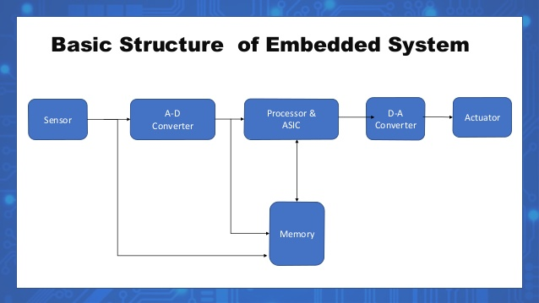

Slide 9
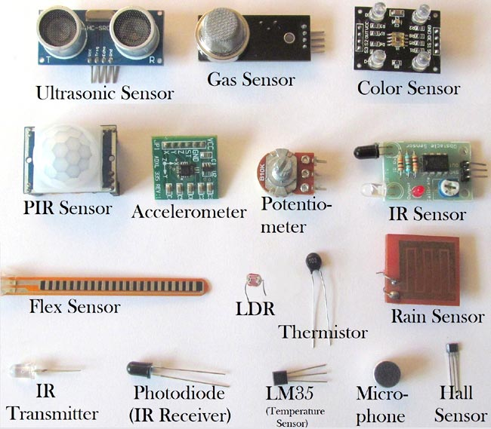
sensors are termed as the devices that generate an electrical signal or optical output signal corresponding to the variations in the level of inputs.
Temperature Sensor
IR Sensor
Ultrasonic Sensor
Touch Sensor
Proximity Sensors
Pressure Sensor
Level Sensors
Smoke and Gas Sensors

Slide 10
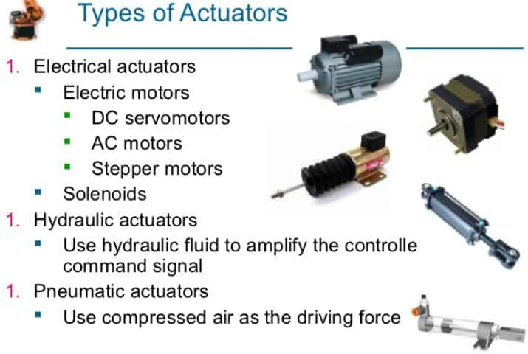
An actuator is a part of a device or machine that helps it to achieve physical movements by converting energy, often electrical, air, or hydraulic, into mechanical force.
Electric motors
Solenoids
Hard drive stepper motors
Hydraulic cylinder
Piezoelectric actuator

Slide 11
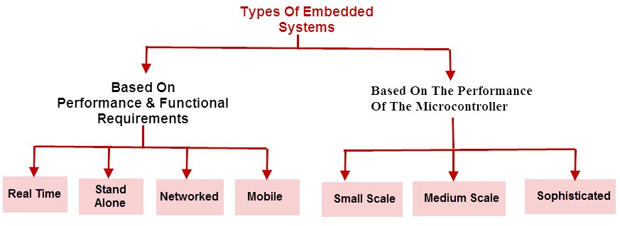
Classification of Embedded System

Slide 12
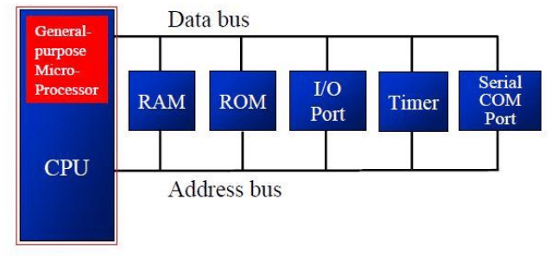
MICROPROCESSOR
Peripherals are connected Externally

Slide 13
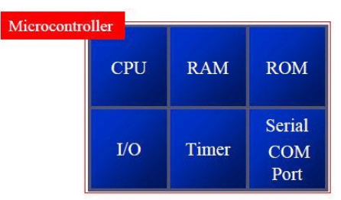
MICROCONTROLLER
Peripheral are available on Chip

Slide 14
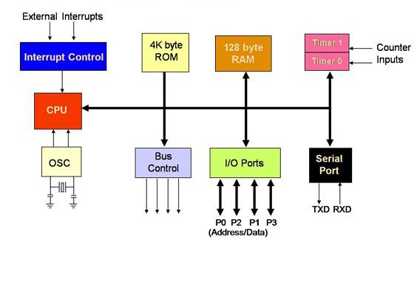

Slide 15
Microprocessor | Microcontroller
CPU is stand-alone, RAM, ROM, I/O, timer are separate | CPU, RAM, ROM, I/O and timer are all on a single chip
Designer can decide on the amount of ROM, RAM and I/O ports. | Fixed amount of on-chip ROM, RAM, I/O ports
Versatility of applications | Limited Applications
General-purpose | Specific -purpose (control-oriented)
Typically deep pipeline (5 stages) | Typically single-cycle/two-3 stage pipeline
High power consumption | Low power consumption
Instruction sets focus on processing-intensive operations | Instruction sets focus on control and bit-level operations

Slide 16
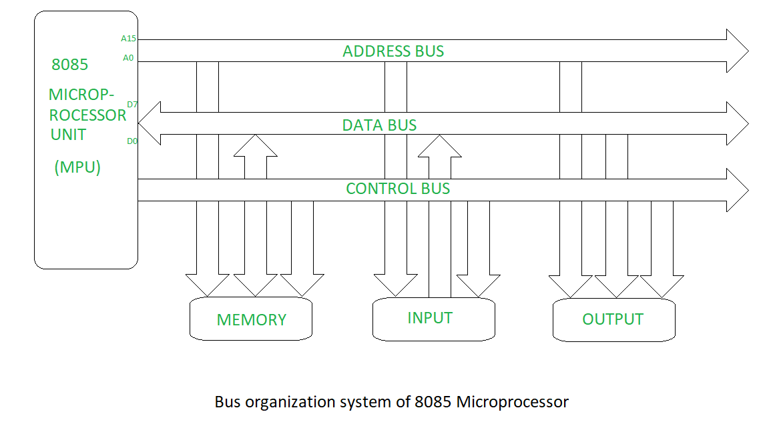
Address, Data Bus, Control Bus

Slide 17
RISC and CISC
CISC (Complex Instruction Set Computing)
  Large number of instructions
  Complex Instructions available
  Less number of registers
  Operations on Registers & Memory
  Variable length instructions
  Pipelining difficult
  Intel x86 family, Motorola 68000 series processor.

Slide 18
RISC (Reduced Instruction Set Computing)
  Limited number of instructions
  Simpler processor architecture
  Complex instruction obtained by executing a sequence of simple instructions
  Large number of registers
  Load Store architecture
  Fixed length instructions
  Pipelining is easy.
  ARM,ATMEL AVR, Microchip, PIC

Slide 19
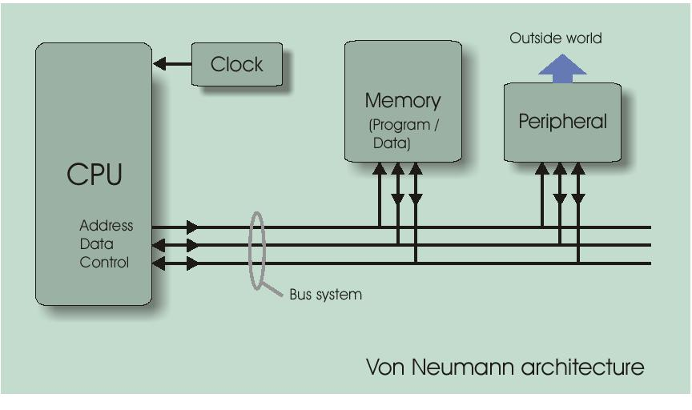
Von Neumann Architecture: (Single Memory)

Slide 20
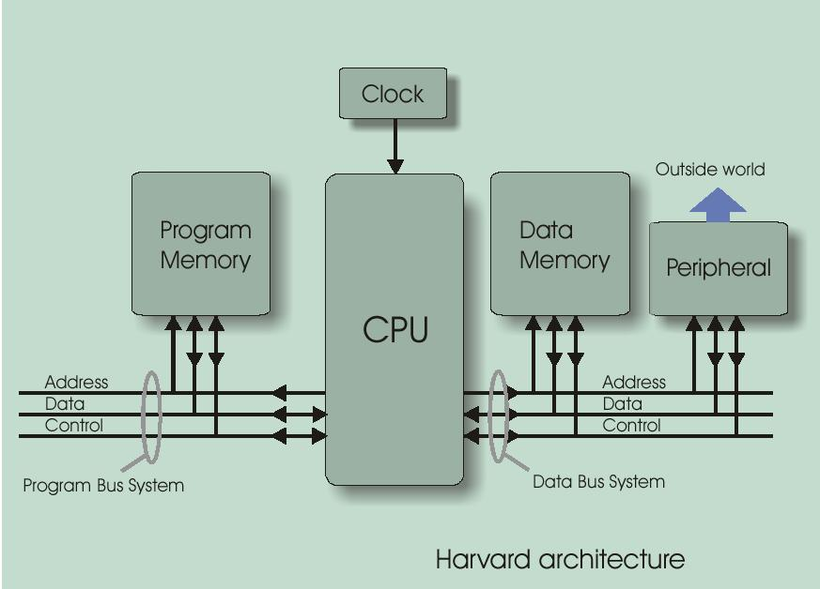
Harvard Architecture (Dual Memory )

Slide 21
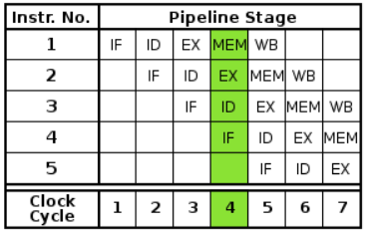
Pipelining
Pipelining is a process of arrangement of hardware elements of the CPU such that its overall performance is increased.
Simultaneous execution of more than one instruction takes place in a pipelined processor.

Slide 22
Synchronous and Asynchronous Buses
Synchronous | Asynchronous
Clocked | Not clocked
Every device must run at same clock rate | Wide range of devices Can be connected with different delay
Very little logic and very fast. | Requires handshaking protocol
Cannot be very long if fast. | Slow, But Long Transmission
Between CPU and Memory | Suited for communication between CPU and peripherals
Ex: USART, SPI | Ex: UART

Slide 23
Communication Protocols
Communication Protocols are a set of rules that allow two or more communication systems to communicate data via any physical medium.
The rules, regulations, synchronization between communication systems, syntax to be followed and semantics are all defined by the term protocol.
Protocols can be implemented by both hardware and software or combination of both.
In general, the communication protocols is associated with physical layer describing the signals incorporated, signal strength, hand shaking mechanism, bus arbitration, device addressing, wired or wireless, data lines etc.

Slide 24
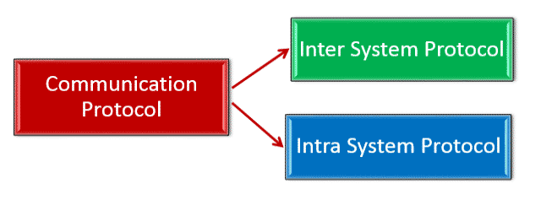
Types of Communication Protocols in Embedded Systems
Communication protocols are broadly classified into two types:
o Inter System Protocol
o Intra System Protocol

Slide 25
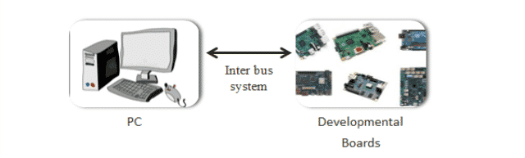
Inter System Communication Protocols
Inter system protocols establish communication between two communicating devices i.e. between PC and microprocessor kit, developmental boards, etc. In this case, the communication is achieved through inter bus system.
Types of Inter System Communication Protocols
o USB Communication protocols
o UART Communication protocols
o USART Communication protocols

Slide 26
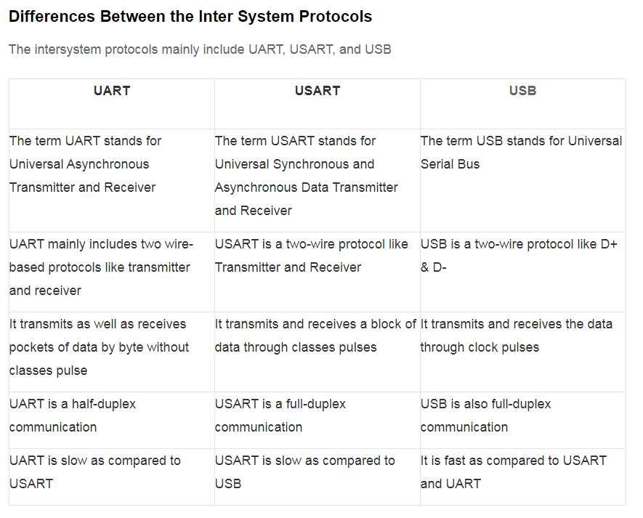

Slide 27
Intra System Communication Protocols
The Intra system protocol establishes communication between components within the circuit board.
In embedded systems, intra system protocol increases the number of components connected to the controller.
Increase in components lead to circuit complexity and increase in power consumption. Intra system protocol promises secure access of data from the peripherals.
In embedded systems, all peripheral devices are connected as memory mapped devices to the microcontroller.
Types of Intra System Communication Protocols
o I2C Protocol
o SPI Protocol
o CAN Protocol

Slide 28
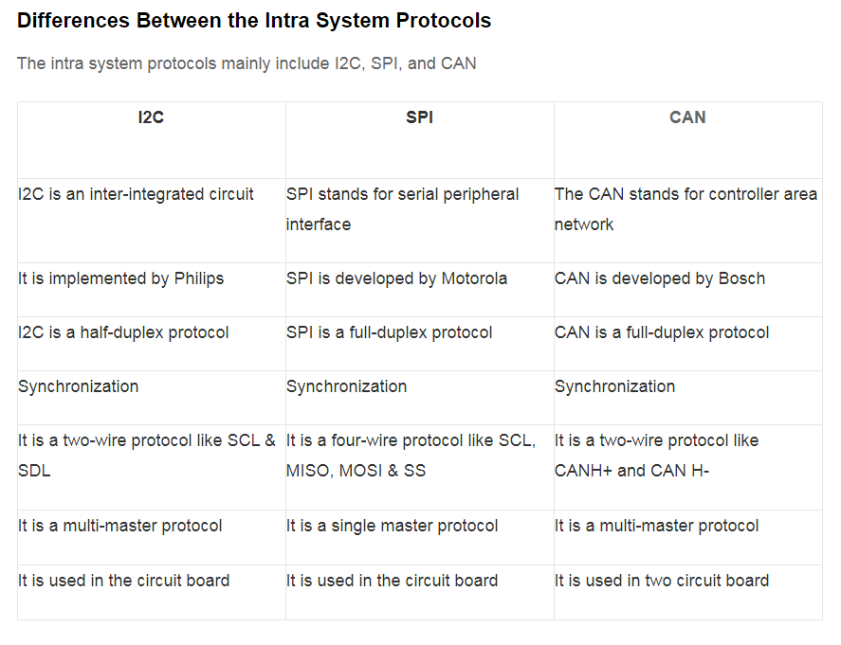

Slide 29
Bluetooth
• Standard: Bluetooth 4.2 core specification
• Frequency: 2.4GHz (ISM)
• Range: 50-150m (Smart/BLE)
• Data Rates: 1Mbps (Smart/BLE)
GSM (Cellular)
• Standard: GSM/GPRS/EDGE (2G), UMTS/HSPA (3G), LTE (4G)
• Frequencies: 900/1800/1900/2100MHz
• Range: 35km max for GSM; 200km max for HSPA
• Data Rates (typical download): 35-170kps (GPRS), 120-384kbps (EDGE),
384Kbps-2Mbps (UMTS),
• 600kbps-10Mbps (HSPA), 3-10Mbps (LTE)

Slide 30
WiFi
• Standard: Based on 802.11n (most common usage in homes today)
• Frequencies: 2.4GHz and 5GHz bands
• Range: Approximately 50m
• Data Rates: 600 Mbps maximum, but 150-200Mbps is more typical, depending on
channel frequency used and number of antennas (latest 802.11-ac standard should
offer 500Mbps to 1Gbps)
ZigBee
• Standard: ZigBee 3.0 based on IEEE802.15.4
• Frequency: 2.4GHz
• Range: 10-100m
• Data Rates: 250kbps

Slide 31
Memory System
Memory
RAM
DRAM
SRAM
Hybrid
NVRAM
FLASH
EEPROM
ROM
EPROM
PROM
Masked

Slide 32
DRAM | SRAM
Constructed from tiny capacitors that leaks the electricity | Constructed from D flip-flop, retains the data
Requires a refresh every few millisecond to maintain its data | Holds its data as long as power is available
Slower than SRAM | Faster than DRAM
Uses less power | Uses more power
Generates Less heat | Generates more heat

Slide 33
EEPROM (Electrically Erasable and Programmable Read Only Memory)
EEPROM is programmed and erased electrically.
It can be erased and reprogrammed about ten thousand times.
Both erasing and programming take about 4 to 10 ms (millisecond).
In EEPROM, any location can be selectively erased and programmed.
Flash Memory
Flash memory can be erased and rewritten faster than ordinary EEPROM, and newer designs has the feature that is very high endurance Bulk data can be programmed and erased within a few milliseconds

Slide 34
PROM (Programmable Read Only Memory)
PROM is read-only memory that can be modified only once by a user.
The user buys a blank PROM and enters the desired contents using a PROM program.
EPROM (Erasable and Programmable Read Only Memory)
EPROM can be erased by exposing it to ultra-violet, and user can reprogram it again for further application.
Mask ROM (MROM)
Mask ROM (MROM) is a type of ROM whose contents are programmed by the integrated circuit manufacturer (rather than by the user).

Slide 35
Interrupt
Interrupt is a hardware mechanism in which, the device notices the CPU that it requires its attention.
If CPU gets an interrupt signal trough the indication interrupt-request line, CPU stops the current process and respond to the interrupt by passing the control to interrupt handler which services device.
Microprocessor
Interrupt Request
I/O Device
Interrupt ACK
Data Transfer

Slide 36
Main Pgm
Instruction 1
Instruction 2
INT x
Instruction 3
Instruction 4
Instruction 5
Instruction 6
Push PC
PSR to Stack
Send the Interrupt ACK
Go to ISR
PC⬅ Vector Address
ISR
Instruction 1
Instruction 1
Instruction 1
RET
POP PC
PSR from Stack

Slide 37
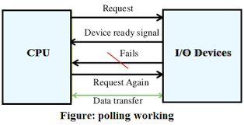
Polling
In polling is not a hardware mechanism, its a protocol in which CPU steadily checks whether the device needs attention.
In polling process CPU keeps asking the I/O device whether it desires CPU processing or not.

Slide 38
S.NO | INTERRUPT | POLLING
1. | In interrupt, the device notices the CPU that it requires its attention. | Whereas, in polling, CPU steadily checks whether the device needs attention.
2. | An interrupt is not a protocol, its a hardware mechanism. | Whereas it isn’t a hardware mechanism, its a protocol.
3. | In interrupt, the device is serviced by interrupt handler. | While in polling, the device is serviced by CPU.
4. | In interrupt, interrupt request line is used as indication for indicating that device requires servicing. | While in polling, Command ready bit is used as indication for indicating that device requires servicing.
5. | In interrupts, processor is simply disturbed once any device interrupts it. | in polling, processor waste countless processor cycles by repeatedly checking the command-ready little bit of each device.

Slide 39
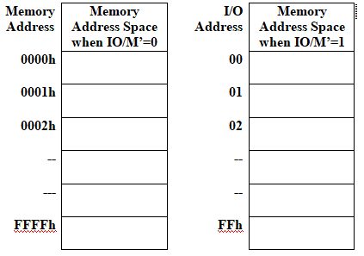
I/O mapped I/O
In I/O mapped I/O mapping, the I/O devices are given a separate addressing region.
Separate from the memory, These separate address spaces are known as ‘Ports’.
If we use 8-bit address lines for creating this special address space for the I/O devices.
That means that we can have an address space of 2^8 = 256 bytes .

Slide 40
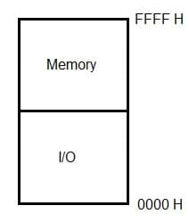
Memory-mapped I/O interfacing
Under the Memory-mapped I/O interfacing, the processor treats the I/O devices like any other memory location.
The I/O devices are efficiently mapped into the system memory along with the RAM and ROM memory.
These devices are assigned with a 16/32 bit address value within the entire address range
If data is to be exchanged with these devices, they follow the data transfer instructions that we usually use when we work with memory.

Slide 41
THANK YOU

